Slide 1
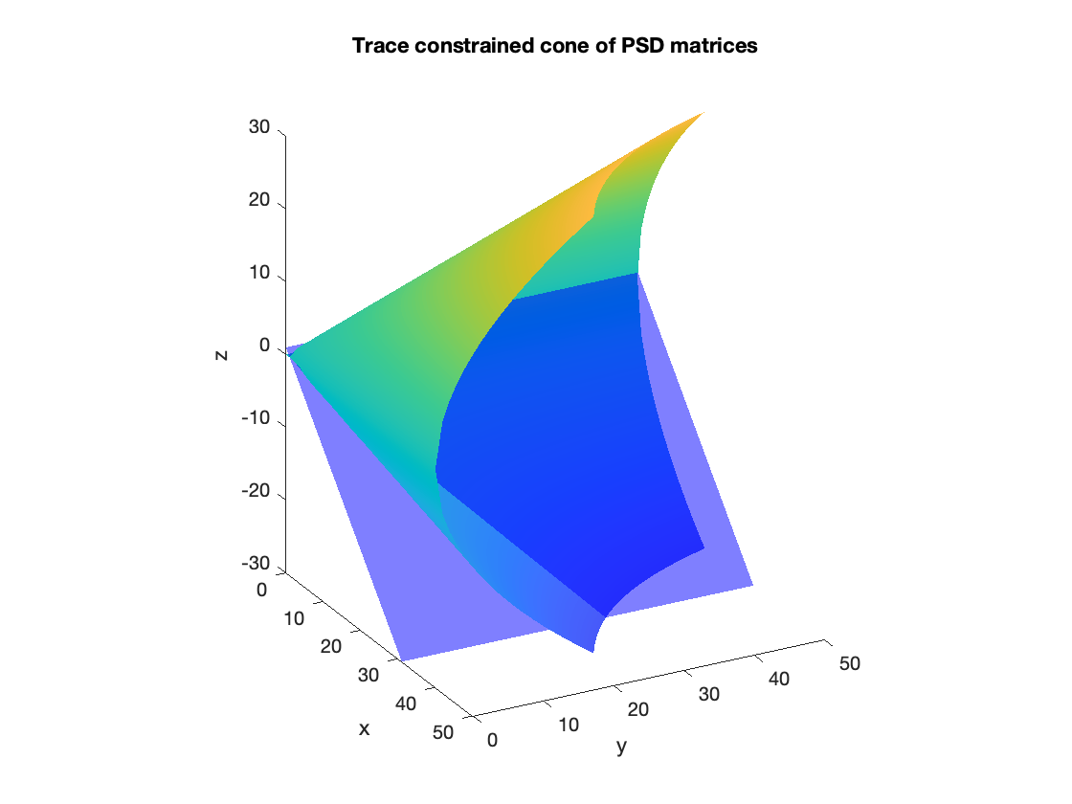
Low-Rank Augmented Lagrangian Methods for Large-Scale SDP
An implementation of the HALLaR algorithm in Python
École Polytechnique Fédérale de Lausanne
Edvin Dannäs
20/6-2024

Slide 2
Agenda
Introduction to concepts
Semidefinite Programming
Augmented Lagrangian methods
Low Rank methods
Algorithm Design (HALLaR)
Implementation (Python)
Performance Evaluation
Conclusion

Slide 3
Semidefinite programming (SDP)
Introduction to concepts
Semidefinite Programming
Augmented Lagrangian methods
Low Rank methods
Algorithm Design (HALLaR)
Implementation (Python)
Performance Evaluation
Conclusion
Minimizing linear objective function for PSD matrices subject to linear matrix constraints. [1]
Generalization of linear programming (LP):
Domain: vectors → matrices
Constraints: non-negativity → PSD
Feasible region: polyhedron (lin. ineq. on vectors) → convex set of matrices
Many practical applications:
Machine learning, signal processing, combinatorial optimization, control theory, etc…

Slide 4
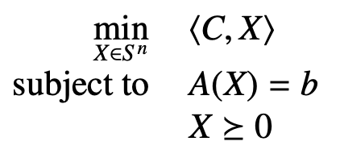
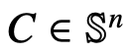
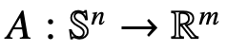
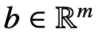
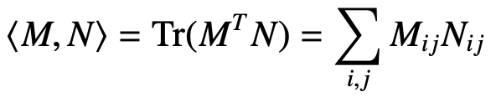
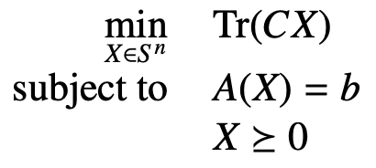
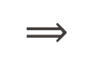
Semidefinite programming (SDP)
Introduction to concepts
Semidefinite Programming
Augmented Lagrangian methods
Low Rank methods
Algorithm Design (HALLaR)
Implementation (Python)
Performance Evaluation
Conclusion
Mathematical formulation:
where
,
and
(Frobenius inner product)
$$⟹$$

Slide 5
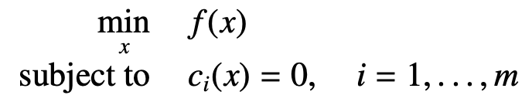
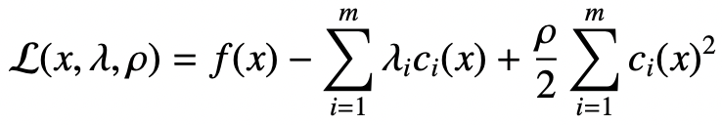
Augmented Lagrangian methods
Introduction to concepts
Semidefinite Programming
Augmented Lagrangian methods
Low Rank methods
Algorithm Design (HALLaR)
Implementation (Python)
Performance Evaluation
Conclusion
”Relaxing” constrained optimization problems, using Lagrange multipliers and an additional quadratic term
For the following constrained optimization problem
The augmented Lagrangian function is defined as

Slide 6
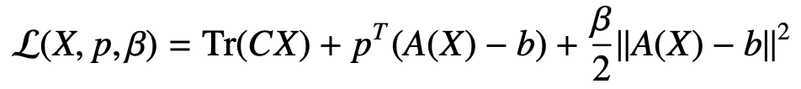
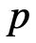
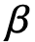
Augmented Lagrangian methods
Introduction to concepts
Semidefinite Programming
Augmented Lagrangian methods
Low Rank methods
Algorithm Design (HALLaR)
Implementation (Python)
Performance Evaluation
Conclusion
”Relaxing” constrained optimization problems, using Lagrange multipliers and an additional quadratic term
For the general SDP formulation:
with
vector of lagrangian multipliers, and
penalty parameter

Slide 7
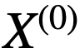
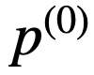
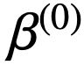
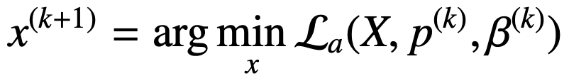
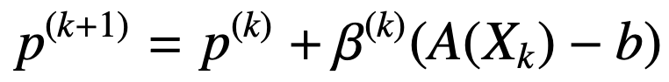
Augmented Lagrangian methods
Introduction to concepts
Semidefinite Programming
Augmented Lagrangian methods
Low Rank methods
Algorithm Design (HALLaR)
Implementation (Python)
Performance Evaluation
Conclusion
Algorithm:
Initialize
At k, solve
Update Lagrangian multipliers:
(Update penalty parameter )
Check convergence criterion
,
and
Repeat until convergence criterion is met

Slide 8
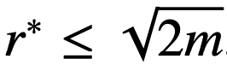
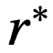
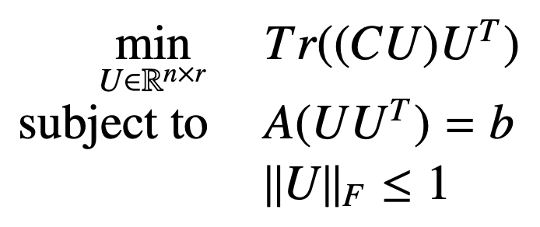
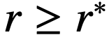
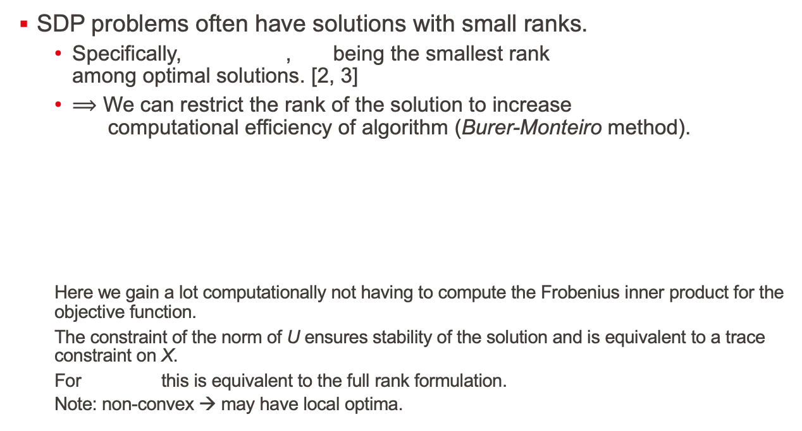
Low Rank methods
Introduction to concepts
Semidefinite Programming
Augmented Lagrangian methods
Low Rank methods
Algorithm Design (HALLaR)
Implementation (Python)
Performance Evaluation
Conclusion
SDP problems often have solutions with small ranks.
Specifically, , being the smallest rank among optimal solutions. [2, 3]
$⟹$ We can restrict the rank of the solution to increase computational efficiency of algorithm (Burer-Monteiro method).
Here we gain a lot computationally not having to compute the Frobenius inner product for the objective function.
The constraint of the norm of U ensures stability of the solution and is equivalent to a trace constraint on X.
For this is equivalent to the full rank formulation.
Note: non-convex → may have local optima.

Slide 9
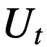
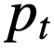
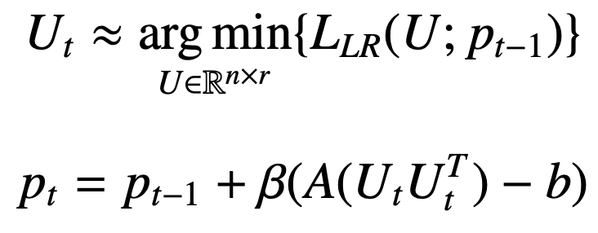
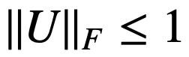
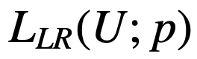
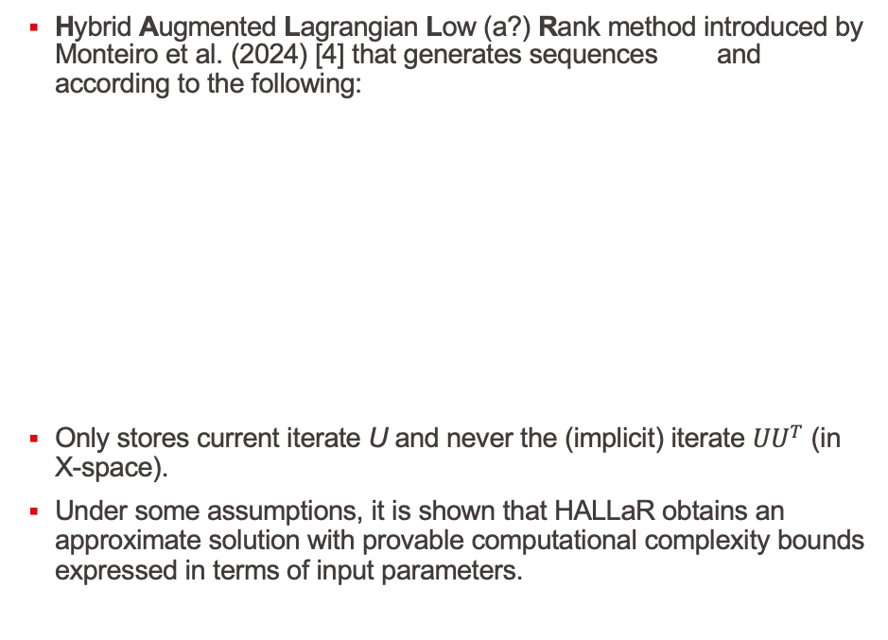
Algorithm Design (HALLaR)
Introduction to concepts
Semidefinite Programming
Augmented Lagrangian methods
Low Rank methods
Algorithm Design (HALLaR)
Implementation (Python)
Performance Evaluation
Conclusion
Hybrid Augmented Lagrangian Low (a?) Rank method introduced by Monteiro et al. (2024) [4] that generates sequences and according to the following:
Only stores current iterate U and never the (implicit) iterate $UU^{T}$ (in X-space).
Under some assumptions, it is shown that HALLaR obtains an approximate solution with provable computational complexity bounds expressed in terms of input parameters.
,
Where is the low rank formulation of the augmented Lagrangian function:

Slide 10
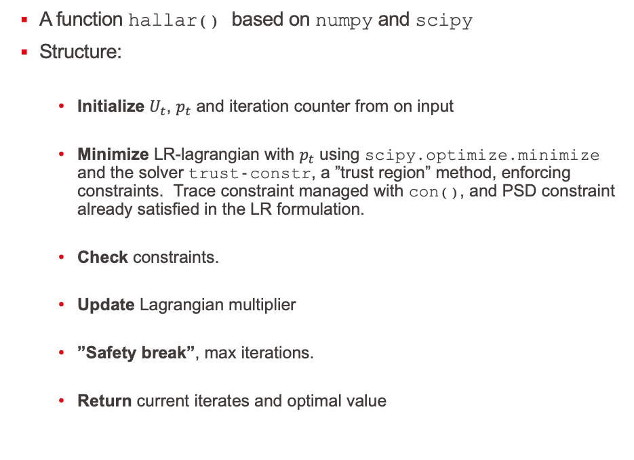
Implementation (Python)
Introduction to concepts
Semidefinite Programming
Augmented Lagrangian methods
Low Rank methods
Algorithm Design (HALLaR)
Implementation (Python)
Performance Evaluation
Conclusion
A function hallar() based on numpy and scipy
Structure:
Initialize $U_{t}$, $p_{t}$ and iteration counter from on input
Minimize LR-lagrangian with $p_{t}$ using scipy.optimize.minimize and the solver trust-constr, a ”trust region” method, enforcing constraints. Trace constraint managed with con(), and PSD constraint already satisfied in the LR formulation.
Check constraints.
Update Lagrangian multiplier
”Safety break”, max iterations.
Return current iterates and optimal value

Slide 11
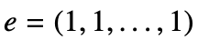
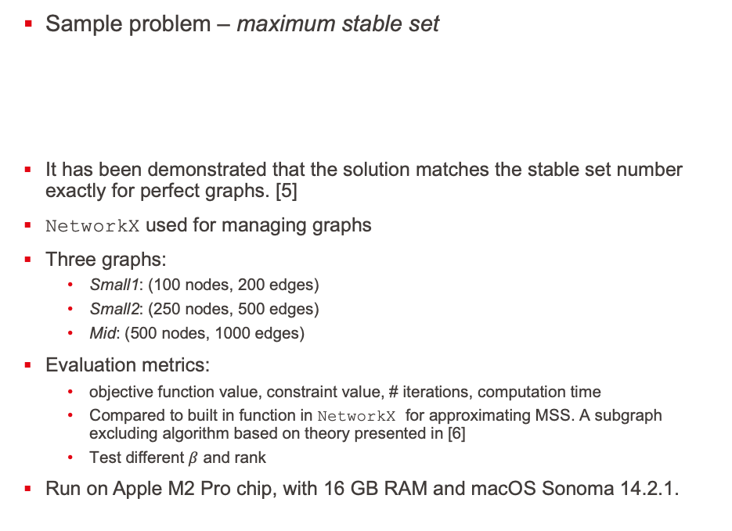
Performance Evaluation
Introduction to concepts
Semidefinite Programming
Augmented Lagrangian methods
Low Rank methods
Algorithm Design (HALLaR)
Implementation (Python)
Performance Evaluation
Conclusion
Sample problem – maximum stable set
It has been demonstrated that the solution matches the stable set number exactly for perfect graphs. [5]
NetworkX used for managing graphs
Three graphs:
Small1: (100 nodes, 200 edges)
Small2: (250 nodes, 500 edges)
Mid: (500 nodes, 1000 edges)
Evaluation metrics:
objective function value, constraint value, # iterations, computation time
Compared to built in function in NetworkX for approximating MSS. A subgraph excluding algorithm based on theory presented in [6]
Test different $β$ and rank
Run on Apple M2 Pro chip, with 16 GB RAM and macOS Sonoma 14.2.1.
With and E the list of edges, and n the number of nodes

Slide 12
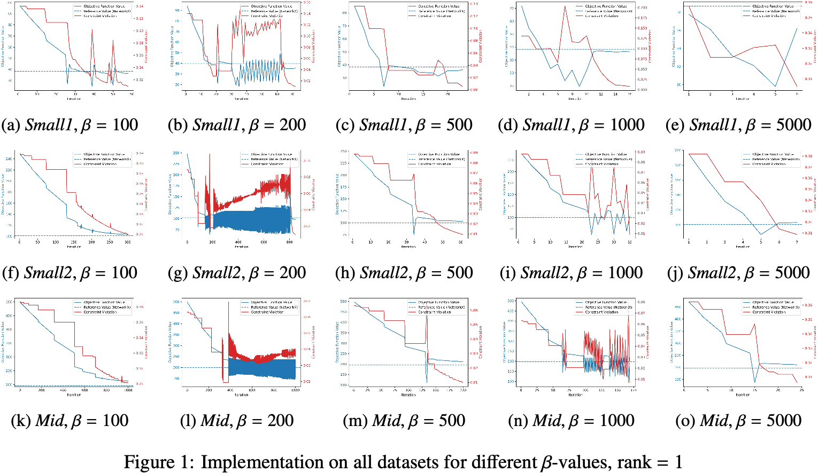

$β$-selection

Slide 13
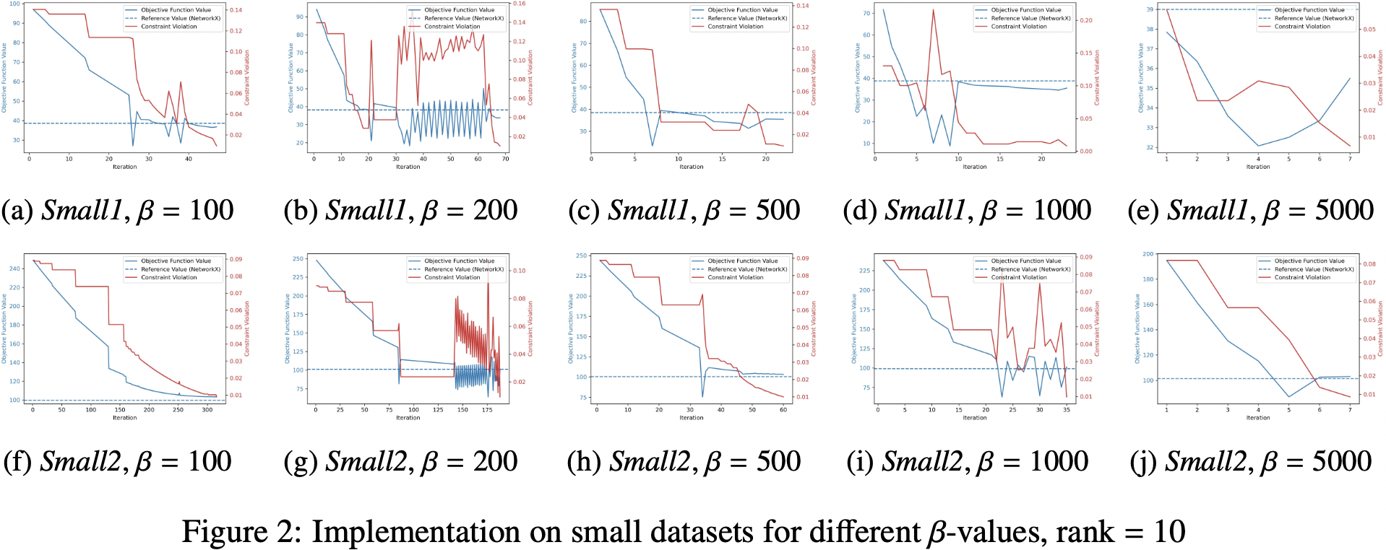
Rank selection

Slide 14
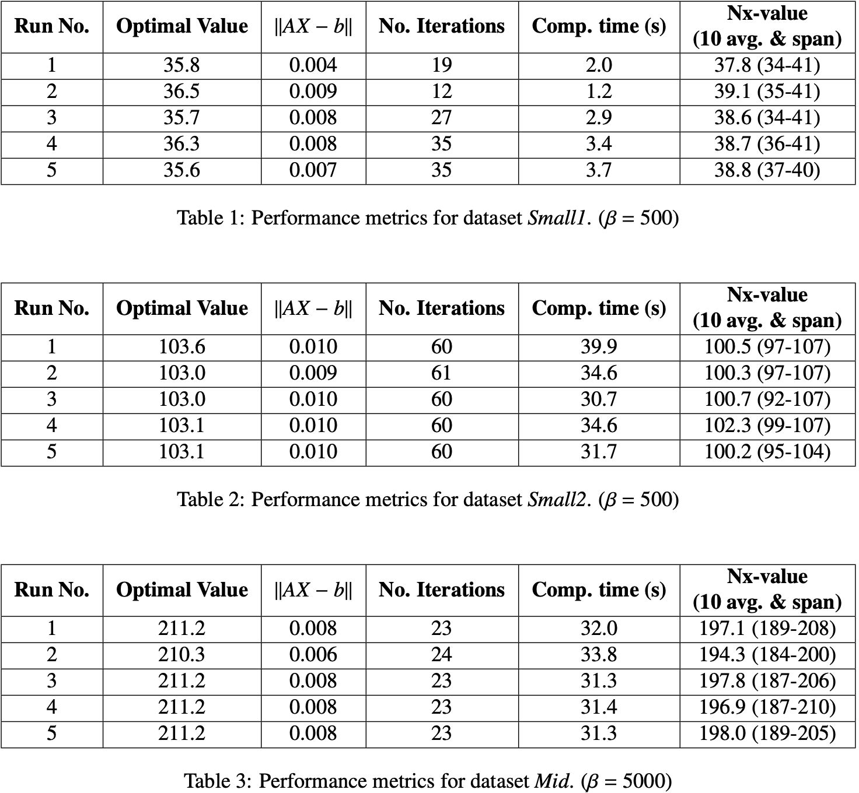
Performance metrics

Slide 15
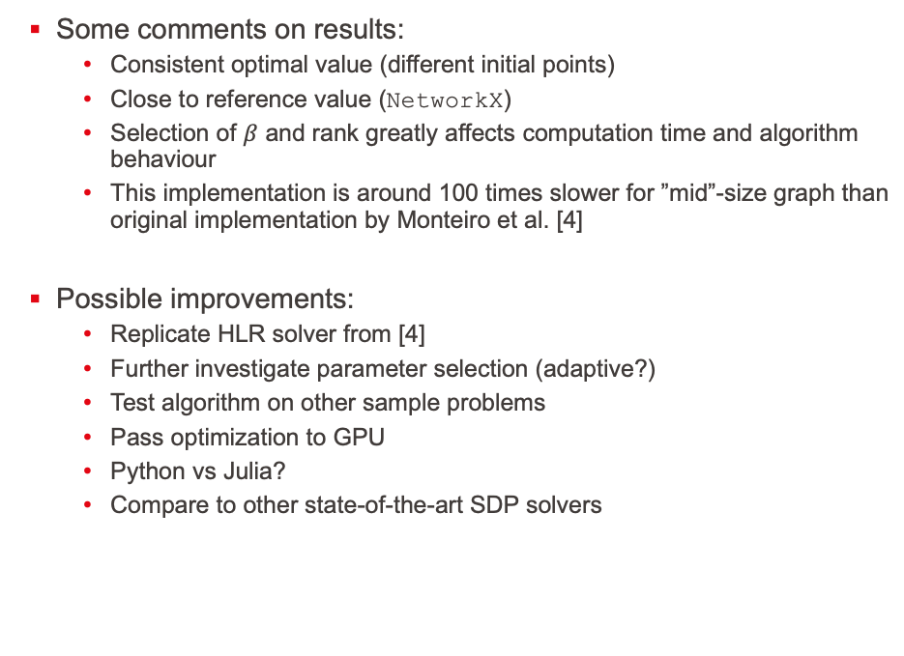
Conclusion
Introduction to concepts
Semidefinite Programming
Augmented Lagrangian methods
Low Rank methods
Algorithm Design (HALLaR)
Implementation (Python)
Performance Evaluation
Conclusion
Some comments on results:
Consistent optimal value (different initial points)
Close to reference value (NetworkX)
Selection of $β$ and rank greatly affects computation time and algorithm behaviour
This implementation is around 100 times slower for ”mid”-size graph than original implementation by Monteiro et al. [4]
Possible improvements:
Replicate HLR solver from [4]
Further investigate parameter selection (adaptive?)
Test algorithm on other sample problems
Pass optimization to GPU
Python vs Julia?
Compare to other state-of-the-art SDP solvers

Slide 16
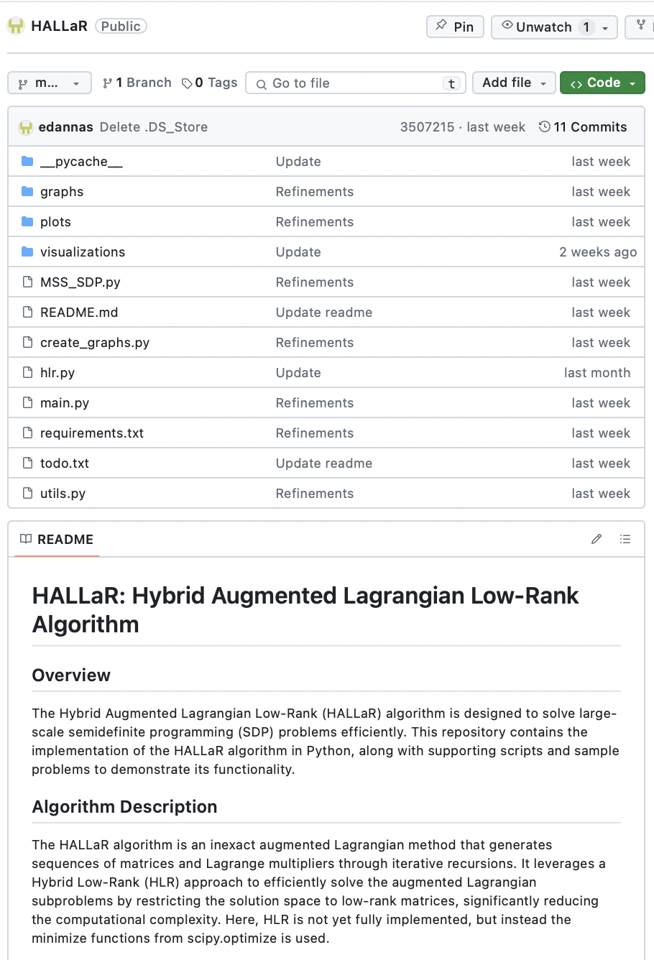
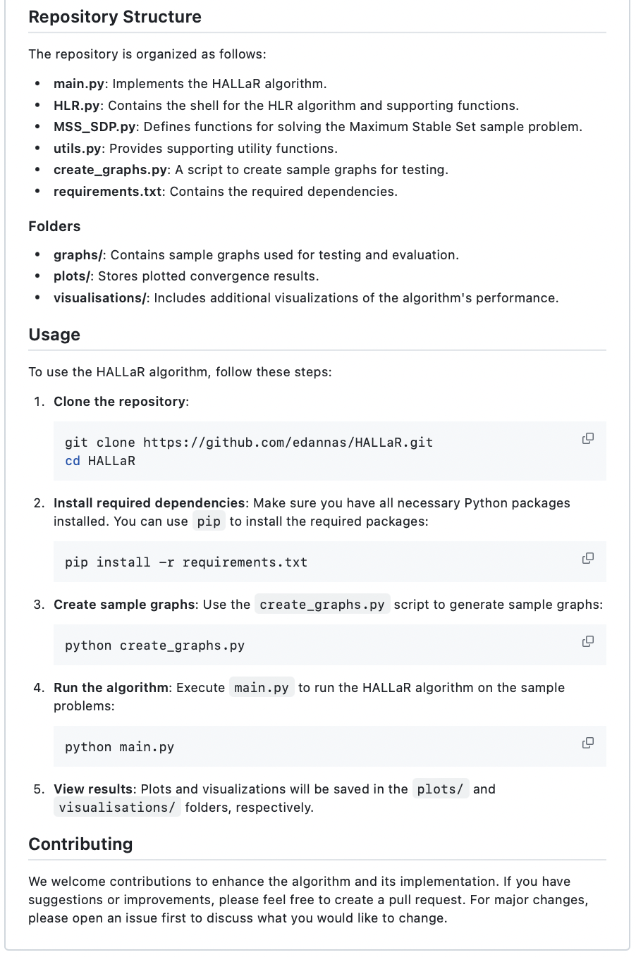


Slide 17
Thank you!
References:
[1] B.Gärtner and J.Matousek, Semidefinite Programming,pp.15-25. Berlin, Heidelberg: Springer Berlin Heidelberg, 2012.
[2] N. Boumal, V. Voroninski, and A. S. Bandeira, “The non-convex burer-monteiro approach works on smooth semidefinite programs,” 2018.
[3] D.Cifuentes, “On the Burer-Monteiro method for general semidefinite programs”, 2020.
[4] R. D. C. Monteiro, A. Sujanani, and D. Cifuentes, “A low-rank augmented lagrangian method for large-scale semidefinite programming based on a hybrid convex-nonconvex approach,” 2024.
[5] L.M. Lovasz, “On the Shannon capacity of a graph”, IEEE Trans. Inf. Theory, vol.25, pp.1–7, 1979.
[6] R. Boppana and M. M. Halldorsson, “Approximating maximum independent sets by excluding sub-
graphs,” BIT Numerical Mathematics, vol. 32, no. 2, pp. 180–196, 1992.

